Slide 1
Hospital Automation: Predicting Patient Readmission
By:
Mohammad Kharoof
Obada Issa
Yara Rashed

Slide 2
Introduction:
A major concern for modern hospitals is counting how many patients are readmitted within 30 days after the original admission. As the healthcare system moves toward value-based care, many programs to improve the quality of care of patients were developed. One of these programs is called the Hospital Readmission Reduction Program (HRRP), which reduces reimbursement to hospitals with above average readmissions. For those hospitals which are currently penalized under this program, one solution is to create interventions to provide additional assistance to patients with increased risk of readmission. Such an early readmission may be planned or unplanned, but the Medicare Payment Advisory Committee reported that 17.6% of U.S. hospital admissions resulted in readmissions within 30 days of discharge.

Slide 3
Project Overview:
The dataset represents 10 years (1999-2008) of clinical care at 130 US hospitals and integrated delivery networks. It includes over 50 features representing patient and hospital outcomes. Information was extracted from the database for encounters that satisfied the following criteria:
(1) It is an inpatient encounter (a hospital admission). (2) It is a diabetic encounter, that is, one during which any kind of diabetes was entered to the system as a diagnosis.
(3) The length of stay was at least 1 day and at most 14 days. (4) Laboratory tests were performed during the encounter. (5) Medications were administered during the encounter.
The data contains such attributes as patient number, race, gender, age, admission type, time in hospital, medical specialty of admitting physician, number of lab test performed, HbA1c test result, diagnosis, number of medication, diabetic medications, number of outpatient, inpatient, and emergency visits in the year before the hospitalization, etc.
The dataset had no null values.
Very few outliers were present and eliminated using IQR method

Slide 4
Emphasis on the Problem:
Medicare’s definition of an early readmission is a readmission that occurred within 30 days of discharge. One patient population that is at increased risk of hospitalization and readmission is that of diabetes. Diabetes is a medical condition that affects approximately 1 in 10 patients in the United States. According to Ostling et al, patients with diabetes have almost double the chance of being hospitalized than the general population.

Slide 5
Objectives:
Process and asses the readiness of the dataset provided.
Data cleaning (nulls and outliers).
Perform EDA for visualizing and understanding the dataset.
Compare correlation of the features to the readmission.
To identify the patients with increased risk of readmission.
Build a predictive model that focuses on predicting hospital readmission for patients with diabetes.
Apply ANN and Decision-Tree classifications.
Develop and deploy the model using Flask framework

Slide 6
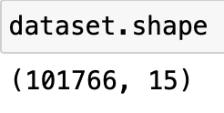
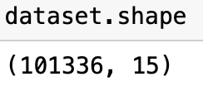
Preprocessing: Getting rid of outliers using IQR
Before:
After:

Slide 7
Preprocessing: Features chosen (14)
Gender
Age
num_lab_procedures
num_procedures
num_medications
number_diagnoses
Metformin
Glimepiride
Glipizide
Glyburide
Rosiglitazone
Insulin
Change
diabetesMed
Readmitted (target)

Slide 8
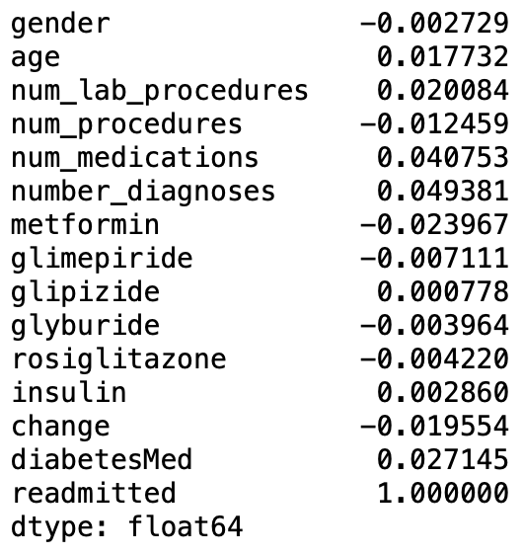
Preprocessing: Correlation between selected features and Redamission

Slide 9
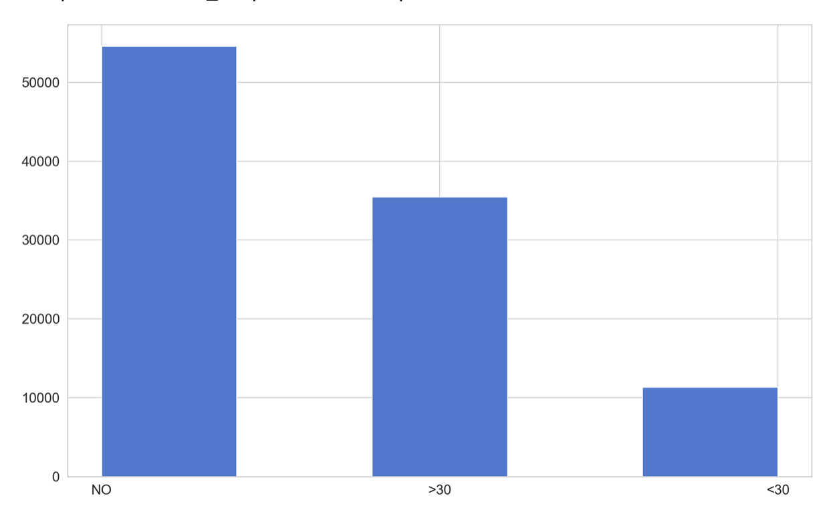
EDA: Readmission counts

Slide 10
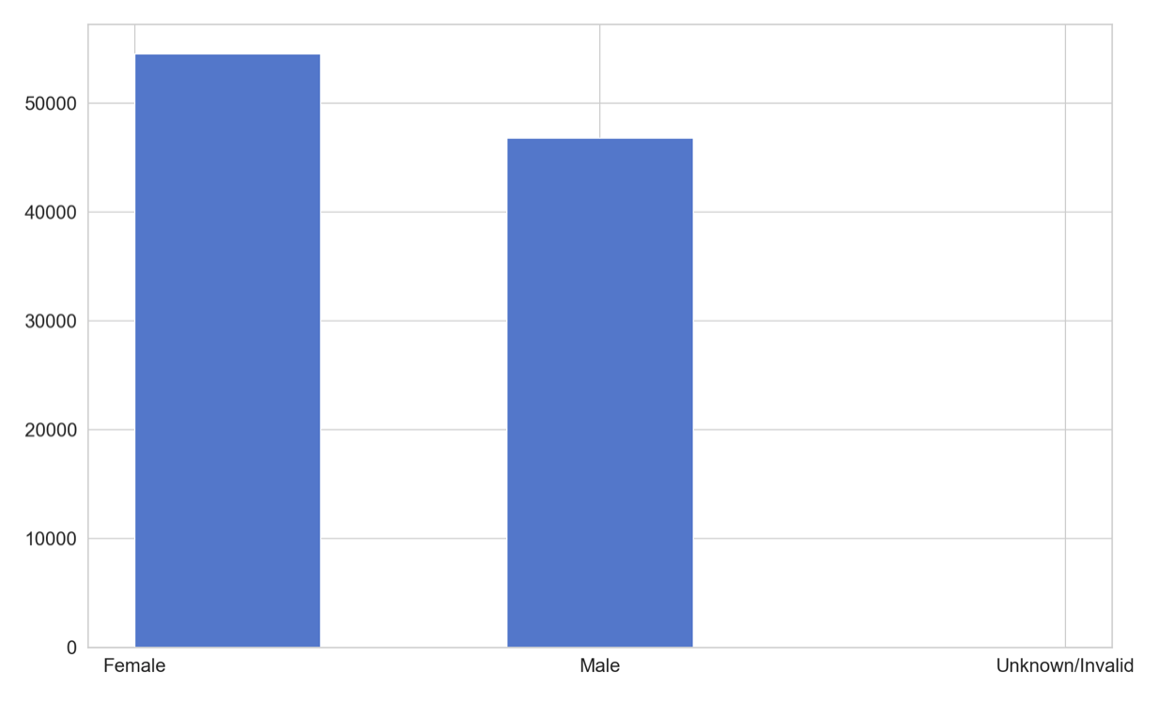
EDA: Gender counts

Slide 11
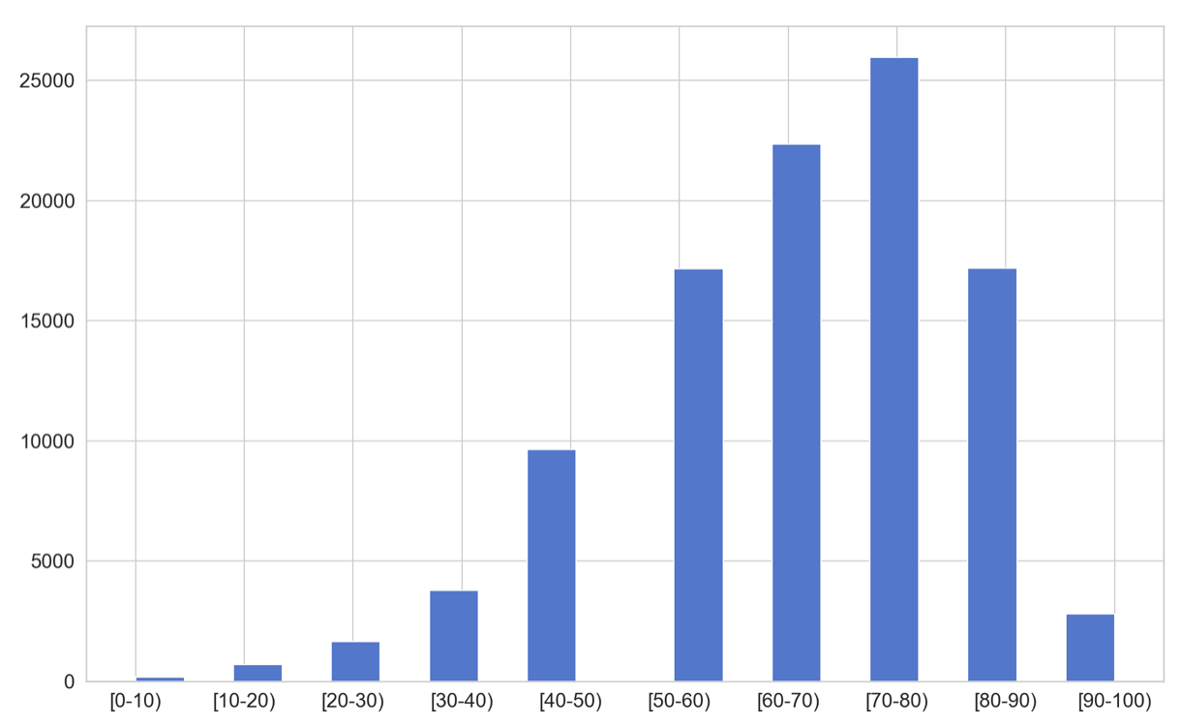
EDA: Age groups count

Slide 12

ML: Train-test splits (90%-10%)
x y

Slide 13
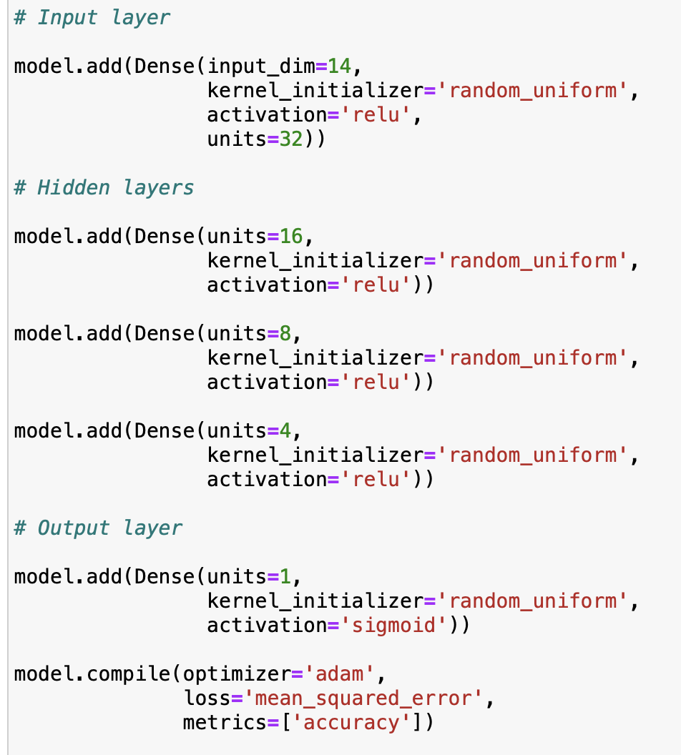
ML: ANN Layers 1 Input layer 3 Hidden layers 1 Output layer
Epochs = 50
Batch size = 256

Slide 14
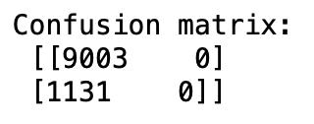

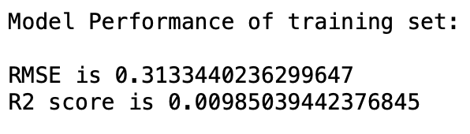
ML: ANN scores

Slide 15
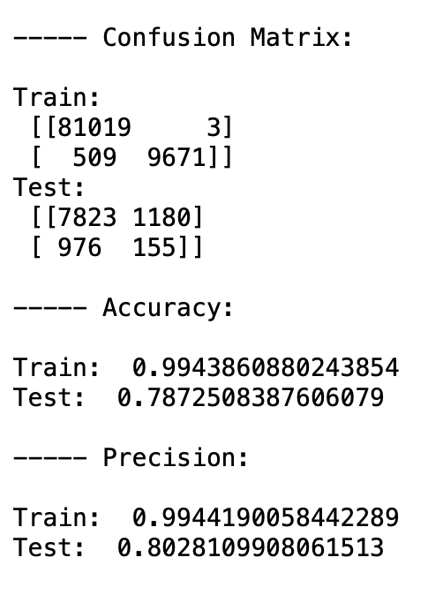
ML: Decision Tree Classifier scores and metrics

Slide 16
Summary:
The model provides relatively high accuracy scores
Many features had to be ignored in order to obtain good scores, meaning many of them have very low to no correlation
Adding more layers to the ANN model raised the accuracy significantly

